Slide 1
ISDS 415
Project #1 Voting Behavior for Gaming Data
Created by Group 5:
Aniket Kodre
Dennis Chen
Matthew Le
Naveen Kumar
California State University, Fullerton
ISDS

Slide 2
Data Cleaning and Pre-Processing
Errors and Anomalies
Remedy
Miscalculation in Total Population . Miscalculation in Population Density as a Result
Miscalculations in Total Votes and Votes For/Against
Null Value in No. of Church Members Column (row 498)
Total Votes are more than Total Population for some given counties.
Wrong formats for percent white, percent black, percent other, percent male, percent female, poverty rate, and unemployment rate.
Outliers in the data set can affect the accuracy of the regression equation.
Different variables have varying scales- for example – No. of churches vs. Population which could lead to inaccurate regression equations.
If there is a high overlap in the data contained in the independent variables while running a multiple linear regression and can lead to overfitting.
Re-calculated sum of all age group numbers and replaced values in the population column using a SUM formula in Excel. Re-calculated population density based on the new population and the size of county.
Re-calculated the total votes as a sum of Votes For / Against and replaced the values using a SUM formula in Excel.
Checked for missing values and their corresponding rows in R and deleted the row.
Removed the rows which contained higher Total votes than total population.
Changed formats of all columns in Excel to the number format.
Checked for outliers of each variable on R and deleted all rows with outlier values.
Normalized all continuous variables in R
Checked the correlation of all the continuous variables in R

Slide 3
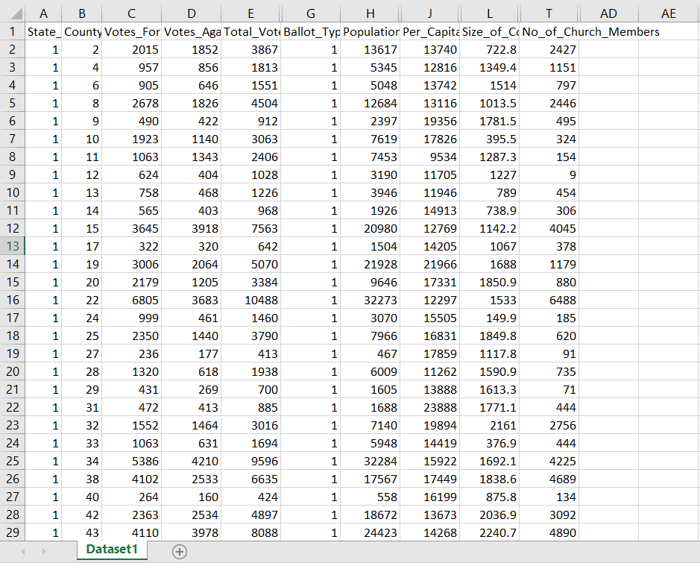
Cleaned dataset (without unused variables)

Slide 4
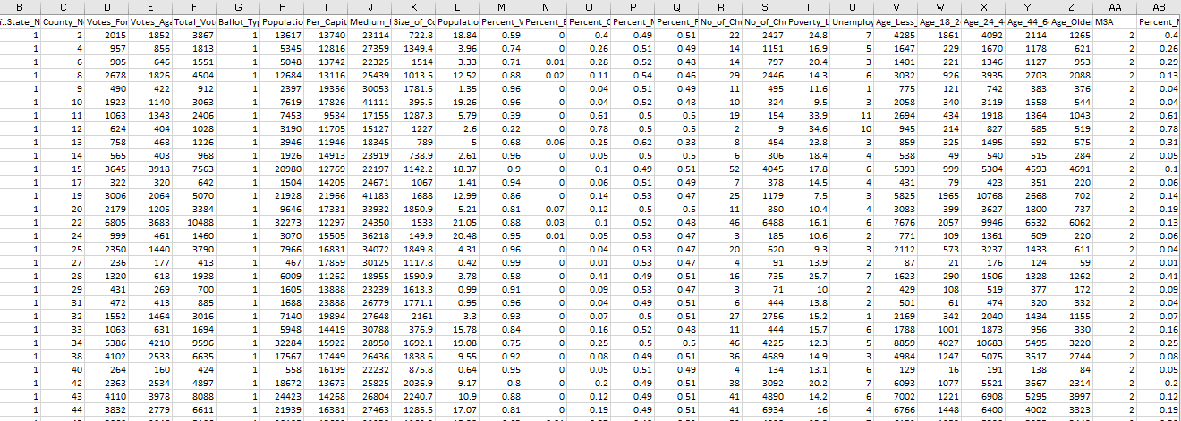
Cleaned dataset

Slide 5
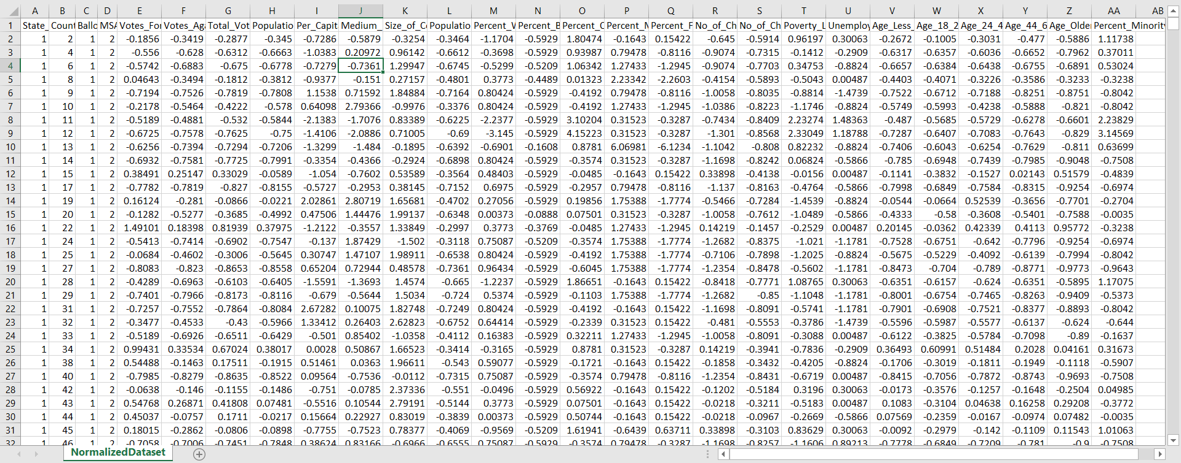
Normalized/Cleaned Dataset

Slide 6
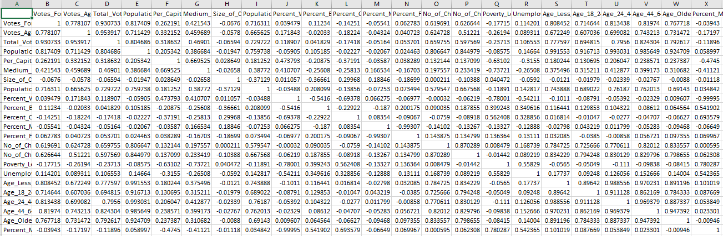
Correlation table

Slide 7
Question #1
Question: Does religion play a role when it comes to voting in favor of the ballots. In other words, does the number of church members affect the outcome in Votes for Ballots 1 and 2?
Null Hypothesis: There is no linear relationship between number of church members and
Votes for.
Alternative Hypothesis: There is a linear relationship between number of church members
and Votes for.

Slide 8
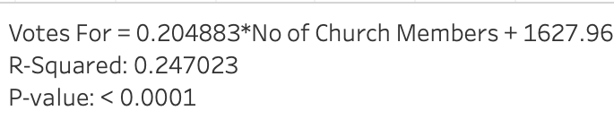
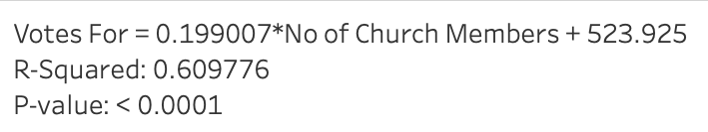
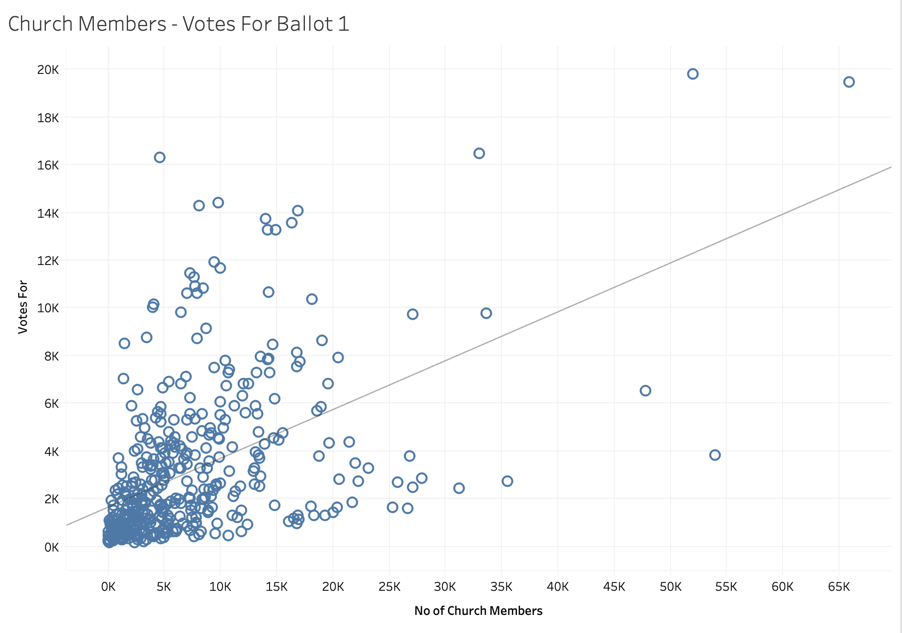
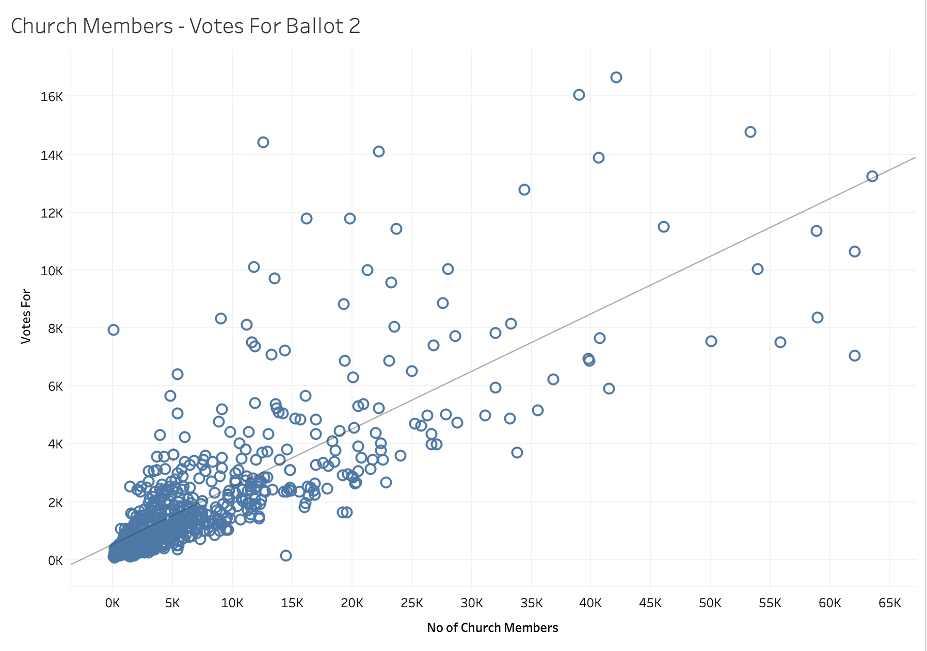
Data Visualization

Slide 9
Analysis
Ballot 1: With a p-value <0.05 ,we can reject the null hypothesis that there is no linear relationship between the number of church members and Votes for. However, the R² value is only 0.24 and the relationship is not as significant as Ballot 2.
Ballot 2: With a P-value < 0.05 , we can reject the null hypothesis that there is no linear relationship between Number of Church Members and Votes For when it comes to Ballot 2. With a high R² value of of 0.61, this linear relationship is also significant.

Slide 10
Question #2
Question: Does the per capita income affect the outcome number of votes in favor of the ballots ?
Null Hypothesis: There is no linear relationship between per capita income and
Votes for.
Alternative Hypothesis: There is a linear relationship between per capita income and
Votes for.

Slide 11
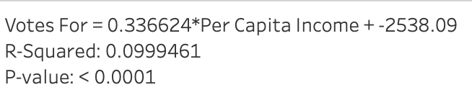
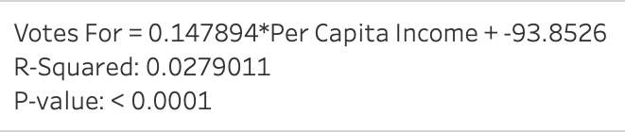
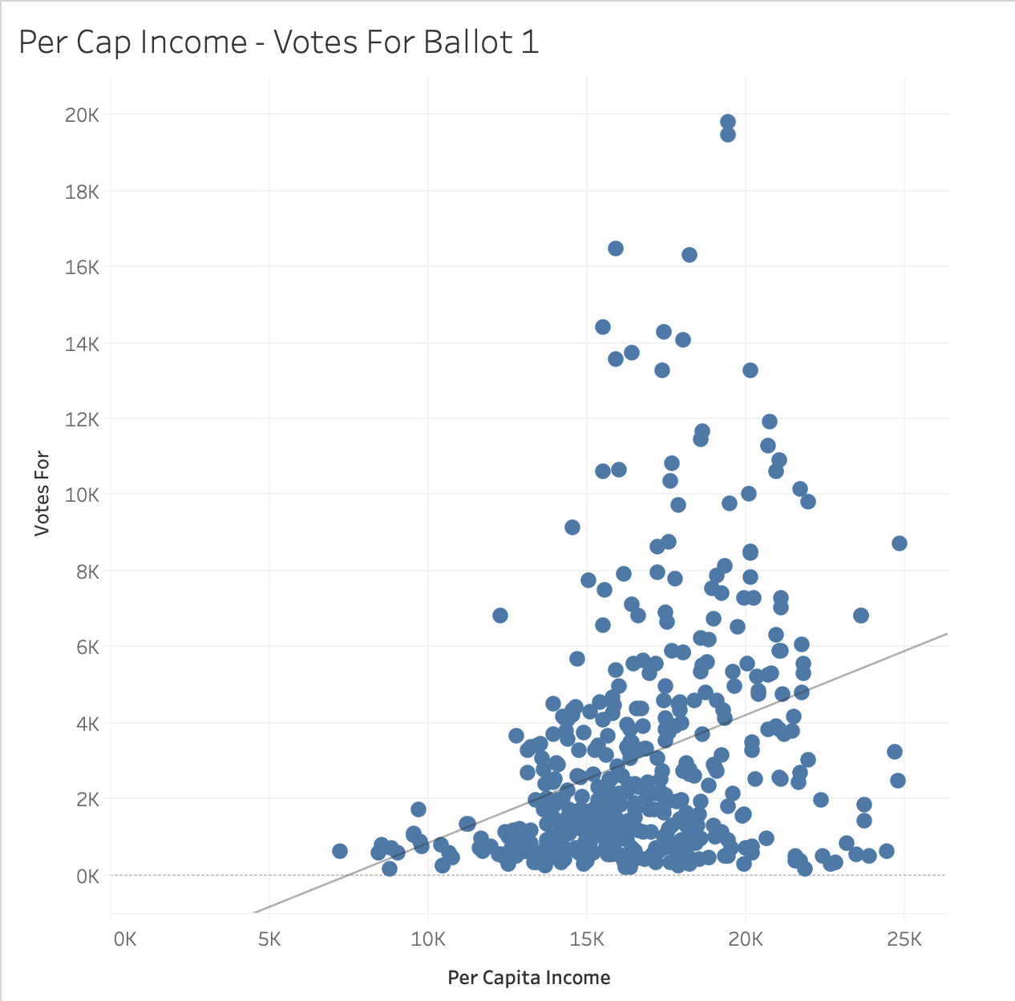
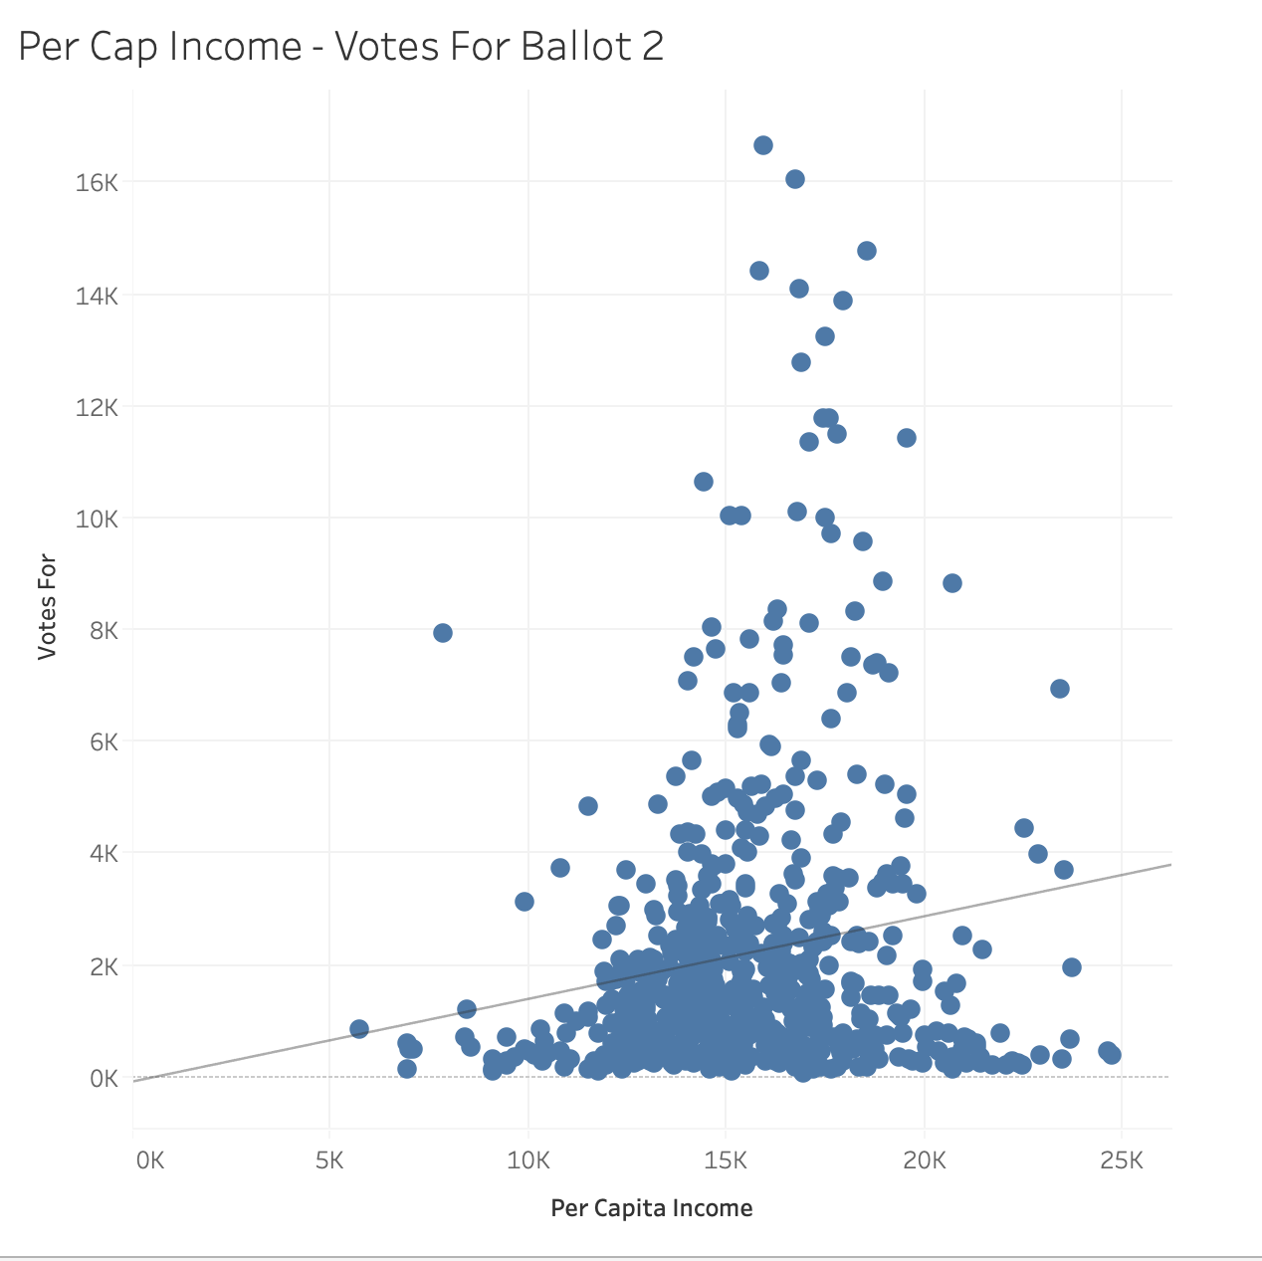
Data Visualization

Slide 12
Analysis
Ballot 1: With a p-value <0.05, we can reject the null hypothesis that there is no linear relationship between per capita income and Votes for. However, the R² value of 0.099 is quite low and the relationship is almost insignificant and does not represent the proportion of variance in Votes for.
Ballot 2: With a P-Value < 0.05, we can reject the null hypothesis that there is no linear relationship between per capita income and Votes for. However, with such a low R²
value of 0.027, we are left with the knowledge that predictions of future values may not be accurate and have a high range of variability.

Slide 13
Question #3
Question: Does Size of County and Population affect the votes in favor of each of the ballots ?
Null Hypothesis: There is no linear relationship between Size of County and Population with
Votes for.
Alternative Hypothesis: There is a linear relationship between Size of County and Population
with Votes for.
*Explain why we chose these variables here*

Slide 14
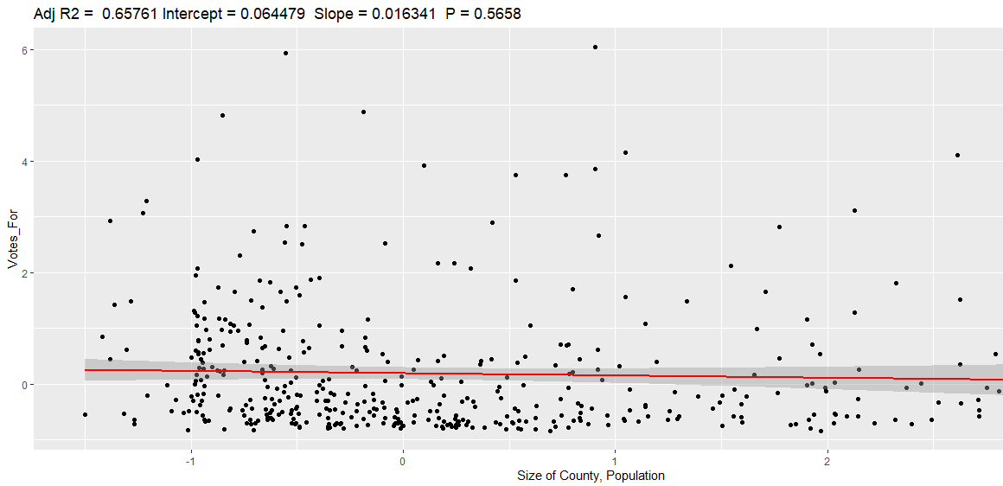
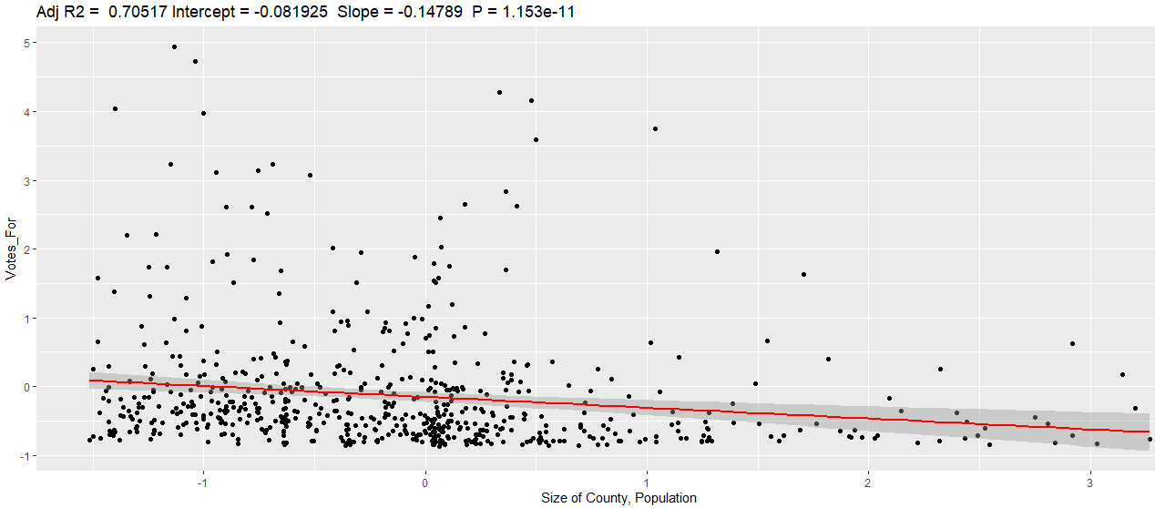
Data Visualization
Ballot 1
Ballot 2

Slide 15
Analysis
We will be using the normalized data set, since the Size of County and Population are on different scales. With a correlation of -0.019, there is very less overlap between the two variables which indicates that they can be a good set of predictor variables to be used.
Ballot 1: WIth a p value <0.05, we can reject the null hypothesis that there is no linear linear relationship between Size of County, Population and the Votes for. With a high R² value of 0.657 , the relationship is also significant.
Ballot 2: WIth a p value <0.05, we can reject the null hypothesis that there is no linear linear relationship between Size of County, Population and the Votes for. With a high R² value of 0.705 , the relationship is quite significant.

Slide 16
Results and Summary for Question 1
The majority of churches have less than 10,000 church members as shown by both graphs. Most of the data points are within 0 to 10,000 members. The graph shows linear relationship between votes for and church members. The relationship is stronger in Ballot 2 and more linear. What we can gather from this is that the high the church members, the higher the votes. Although the votes for both ballots are linear with the number of church members, there are few counties in which number of votes are less with more church members for ballot 1.

Slide 17
Results and Summary for Question 2
For both Ballot 1 and Ballot 2, we can see that the majority of voters are in the between the income range of $10,000 and $25,000. This makes sense because if you have less than $10,000, people don’t want to risk losing what little money they have. Most of the voters are concentrated in the middle of the graph, and the number of votes gets higher the closer it is to the middle. For ballot 1, number of voters(greater than 8,000) was greater than the number of voters for ballot 2, within the income range of $10,000 and $25,000. Number of votes were spread evenly in income range $20,000 to $25,000 for ballot 1, but the votes were very less in the same range for ballot 2.

Slide 18
Results and Summary for Question 3
We can see that most of the population/size of county are in the low range of voting. The majority of data points are concentrated in the lower left corner. Most of these points are between 1 and -1 for Votes For. There are however points that above 1, but the frequency of these points are significantly less than the points lower than 1. We can gather that the majority of the population/size of county don’t vote for “Votes for” a lot.

Slide 19
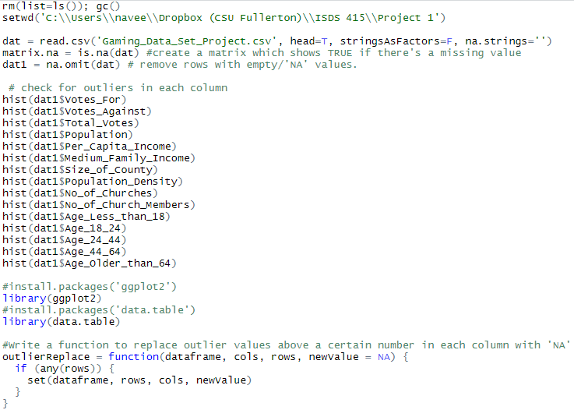
Pre-processing – R screenshot
Appendix

Slide 20
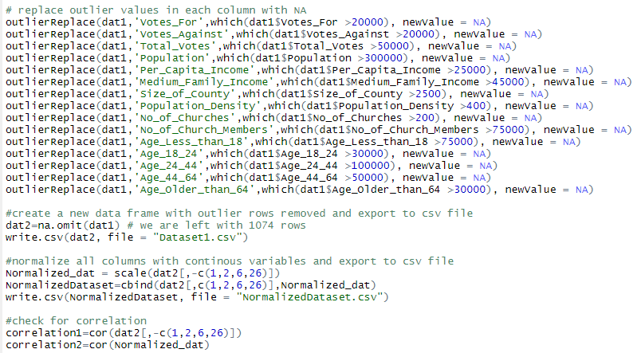
Pre-processing – R screenshot

Slide 21
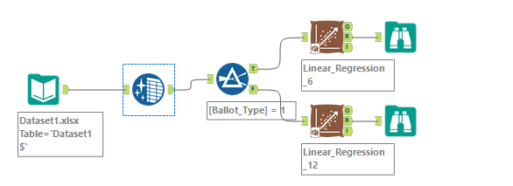
Alteryx 2019.3 workflow screenshot

